Slide 1
For Live Session
UNIT 3

Slide 2
For Live Session: Unit 3
Part 1: We would like to analyze the Left Midfielders (LM) versus the Left Forwards (LF). (Estimated / expected time: 2 – 4 hours and at least 2+ slides).
Using the FIFA player data set, filter the data set to create a dataframe that has just the Left Midfielders (LM) and Left Forwards (LF).
Use Ggally and ggpairs() and the dataset you created above above, to plot the categorical variable Position (LM and LF), versus the continuous variables Acceleration and Agility.
Given the plot above, what relationships do you see? Comment on these.
Your client would like to formally test if the mean agility rating of left midfielders is different than that of the left forwards. Perform a 6 – step t-test to test for the difference in these means. (You may skip step 2 (draw and shade) if you like. If you are unfamiliar with the 6-step hypothesis test, see Stat 1 slides or the Bridge Course to review the 6-step hypothesis test.)
Are the assumptions of this test reasonably met? If you have not had Stat 1, simply create a histogram of the agility scores for both groups (LM and LF) and given what you know about the CLT, comment on if you believe the sampling distribution of sample means (of your sample size) will be reasonably normal. In addition, does there look like there is significant visual evidence to suggest the standard deviations are different? ….. If you have had Stat 1, create the plots listed above (and any other plots you might prefer) and be prepared to be a teacher and teach what you know about the assumptions of the t-test and if those are assumption are reasonably met here.

Slide 3
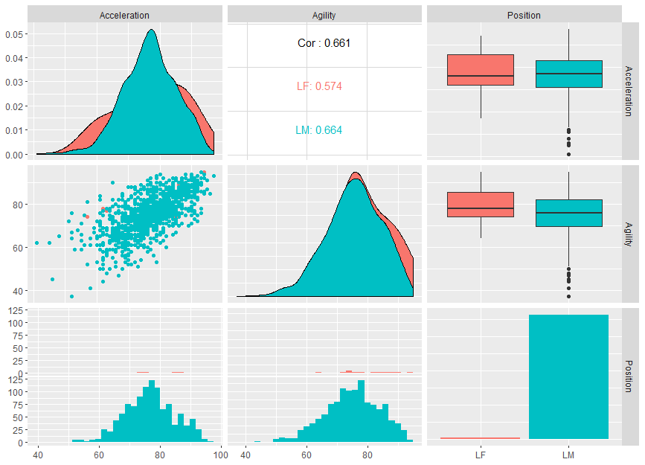
Part 1: Using the FIFA player data set, filter the data set to create a dataframe that has just the Left Midfielders (LM) and Left Forwards (LF). Use Ggally and ggpairs() and the dataset you created above above, to plot the categorical variable Position (LM and LF), versus the continuous variables Acceleration and Agility.
FIFA %>% select(Acceleration, Agility, Position) %>% filter(Position == "LF" | Position == "LM") %>% ggpairs(aes(color = Position))
Given the plot above, what relationships do you see? Comment on these.
There are many more Left Midfielders (LM) in the sample than Left Forwards (LF).
Given the boxplots and the frequency charts, the distribution of Agility does not look significantly different between the two positions although there is some evidence of left skew of both variables in the LM sample. This may not be reflected in the LF sample due to sample size although it may indeed be due to fundamental differences between the positions. We would need more data to be more confident.
There does not appear to be sufficient evidence of a difference in spread (variance) for Acceleration between the LF and LM groups.
Given the scatterplot, there is strong evidence of a positive correlation between agility and acceleration for the LM population and this relationship looks to be consistent with the small sample from the LF group as well.

Slide 4
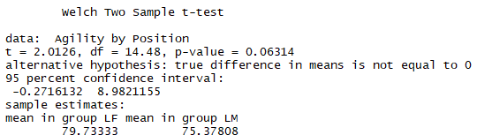
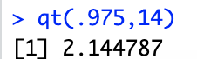
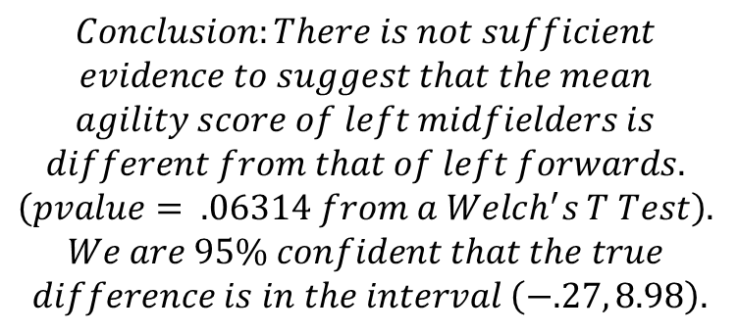
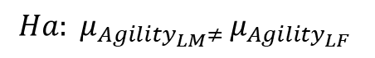
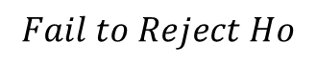
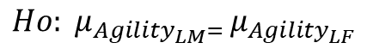
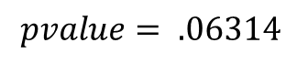
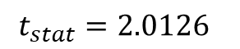
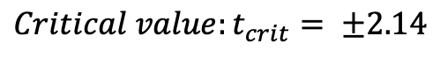
Part 1: Your client would like to formally test if the mean agility rating of left midfielders is different than that of the left forwards. Perform a 6 – step t-test to test for the difference in these means. (You may skip step 2 (draw and shade) if you like. If you are unfamiliar with the 6-step hypothesis test, see Stat 1 slides or the Bridge Course to review the 6-step hypothesis test.)
$$Ho: μ_{Agility_{LM}= }μ_{Agility_{LF} }$$
t.test(Agility~Position, data = FIFA2)
$$Ha: μ_{Agility_{LM}≠ }μ_{Agility_{LF} }$$
$$Critical value:t_{crit}= ±2.14$$
$$t_{stat}=2.0126$$
$$pvalue= .06314$$
$$Fail to Reject Ho$$
$$Conclusion:There is not sufficient$$
$$evidence to suggest that the mean$$
$$agility score of left midfielders is$$
$$different from that of left forwards.$$
$$\left(pvalue= .06314 from a Welch^{′}s T Test\right).$$
$$We are 95\% confident that the true$$
$$difference is in the interval \left(−.27, 8.98\right).$$

Slide 5
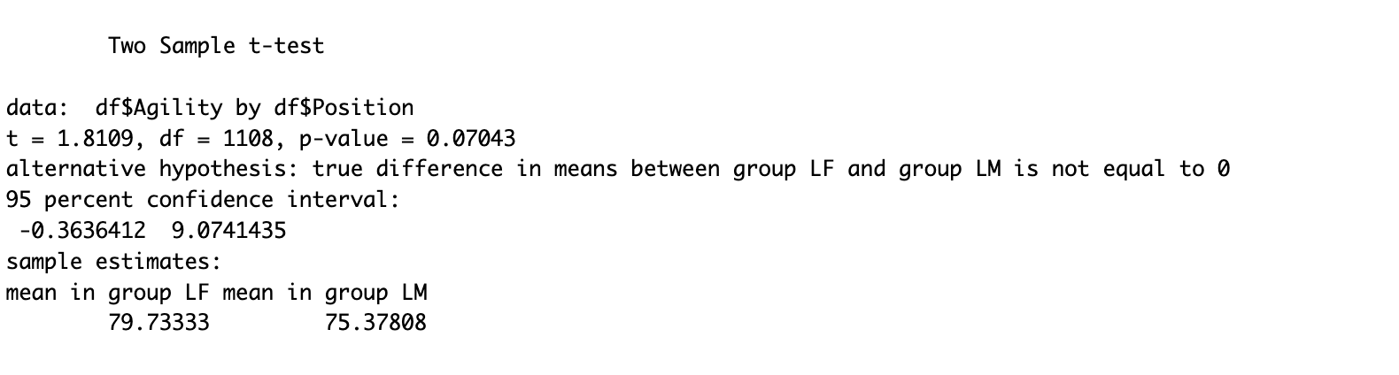
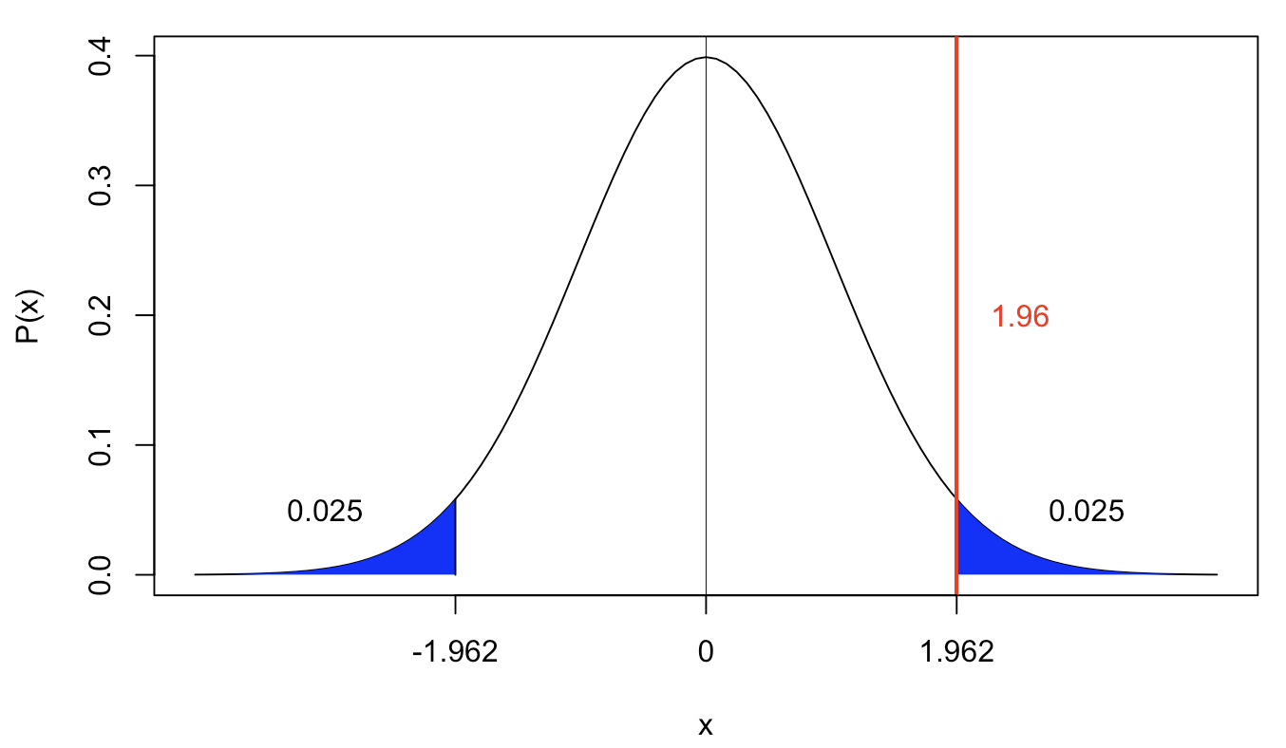
Part 1: Pooled T-Test
The client would like to formally test whether there is a difference in mean agility scores for Left Forwards and Left Midfielders. These are the results of a six-step hypothesis test on this observed difference.
H0: The difference in mean agility scores between Left Forwards and Left Midfielders is equal to 0. HA: The difference in mean agility scores between Left Forwards and Left Midfielders is not equal to 0.
===> See plot to the left… CV = +/- 1.96 df = 1108
Tstat = 1.8109
The Observed Difference in mean agility is 4.355 in
favor of the LFs
4. From a T-test: p-value = 0.07043
5. Fail to Reject the null hypothesis.
6. Conclusion: There is not sufficient evidence to conclude that the mean Agility of Left Forwards is greater than that of Left Midfielders (p = 0.07). This is a random sample from a super population of possible FIFA players and can thus be generalized to the population of all FIFA players. No causation of any effect can be implied because the positions cannot be randomized. See discussion on the following slide about the validity of this study.

Slide 6
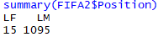
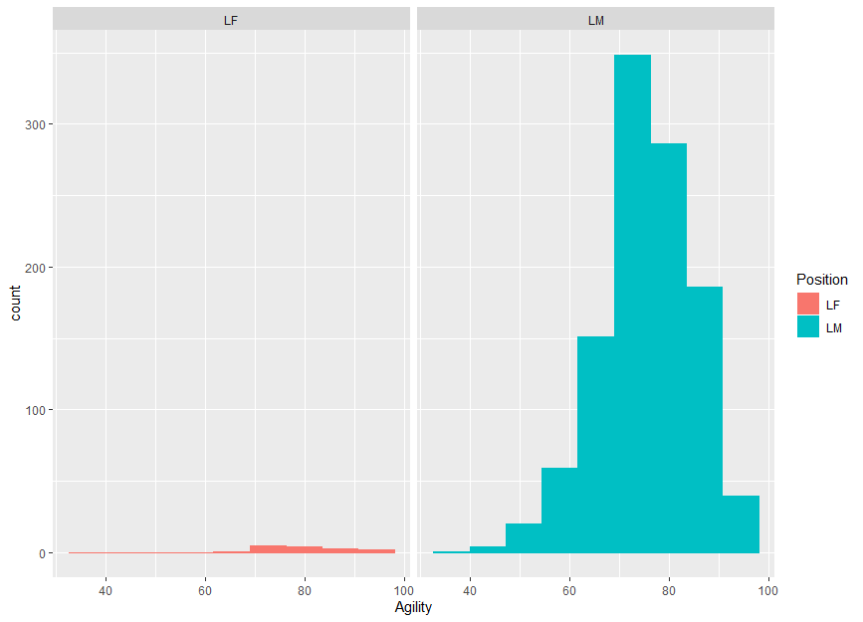
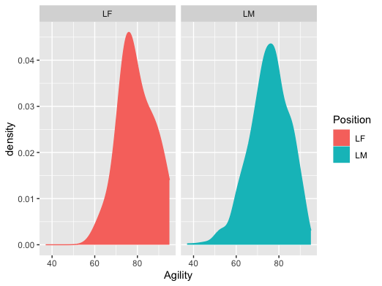
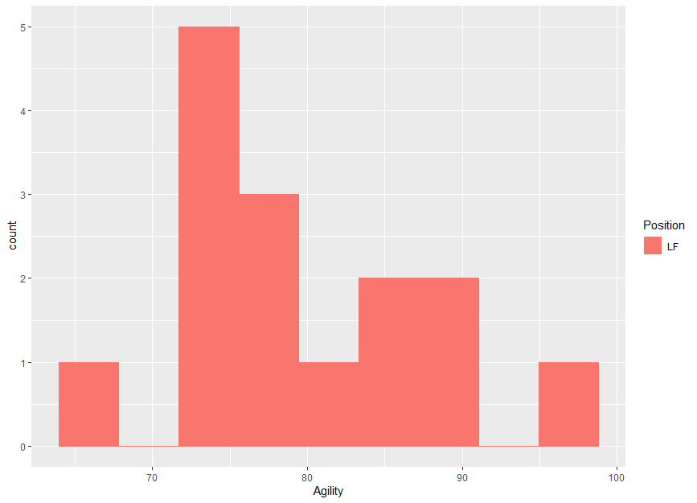
Part 1: Are the assumptions of this test reasonably met?
FIFA2 %>% ggplot(aes(x = Agility, color = Position, fill = Position)) + geom_histogram(bins = 9) + facet_wrap(~Position)
FIFA2 %>% ggplot(aes(x = Agility, color = Position, fill = Position)) + geom_density + facet_wrap(~Position)
Assumptions:
Normal Distributions: There is some evidence that the distribution of agility for LMs is slightly left skewed although we know the t test is robust to this for sample sizes as large as n = 1095. There is some evidence to suggest the agility scores for LFs are right skewed and with a sample size of only 15 we may not have a large enough sample size to ensure that the sampling distribution of the sample mean is approximating a normally distribution reasonably well. However, the histogram does not suggest an egregious distance from a normal distribution if one exists at all and thus we will assume a sample size of 15 is large enough to make the t test robust to this assumption.
Equal Standard Deviations: There is some evidence to suggest that the standard deviations of agility scores of LMs versus LFs are not equal which would be a significant violation given the differing sample sizes. However, we may not be sampling enough LMs to see the lower agilities. The density plots help us to see an estimate of the distribution which sheds little evidence of a significantly different standard deviation. We will run the Welch’s T Test to help us mitigate significant problems with the test.
Independence: We will assume that each player is independent of one another in this sample.

Slide 7


EDA

Slide 8
For Live Session: Unit 3
Part 2: (Estimated / expected time 3-5 hours and at least 3+ slides)
Select/create at least 2 categorical variables and select two continuous variables and perform an EDA. Also, at least one of the categorical variables should be created from a continuous variable (using the cut() function).
Use these variables to explore the data and tell a story of what you discovered similar to what was shown in the asynch videos. You do not need to go so far as to use linear regression, but let your curiosity guide you along the way and feel free to use methods you are familiar with that are appropriate to answering those questions. Your evidence could be purely visual or could include additional methods, it is up to you… just do your best and have fun!

Slide 9
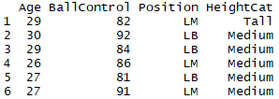
Part 2: (Estimated / expected time 3-5 hours and at least 3+ slides) Select/create at least 2 categorical variables and select two continuous variables and perform an EDA. Also, at least one of the categorical variables should be created from a continuous variable (using the cut() function).
Variables:
Continuous: Ball Control and Age
Categorical: Position (Left Midfield and Left Back) and Height = {Short, Medium, Tall}
FIFA3 = FIFA3 %>% separate(Height,c("Feet","Inches"),sep = "'") %>% mutate(Feet = as.numeric(Feet), Inches = as.numeric(Inches), Height = 12*Feet + Inches)
FIFA3$HeightCat = cut(FIFA3$Height, breaks = c(60,64,70,79), labels = c("Short","Medium", "Tall"))
FIFA3 %>% filter(Position == "LM" | Position == "LB") %>% select(Age, BallControl, Position, HeightCat) %>% head()

Slide 10
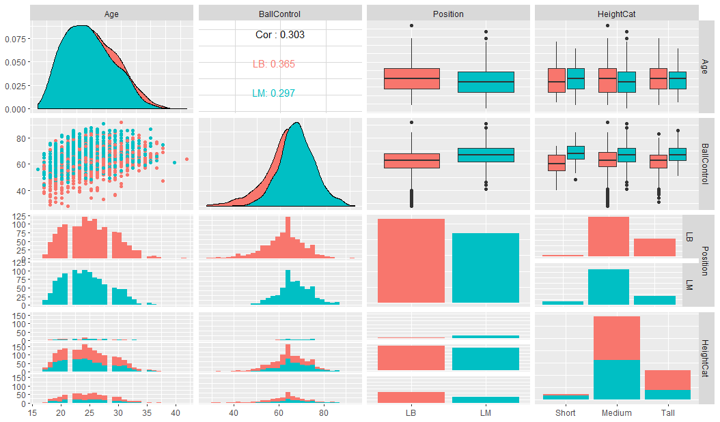
Part 2: Matrix of Plots
FIFA3 %>% filter(Position == "LM" | Position == "LB") %>% select(Age, BallControl, Position, HeightCat) %>% ggpairs(aes(color = Position))

Slide 11
Part 2: Initial Inference from Visual Evidence.
FIFA3 %>% filter(Position == "LM" | Position == "LB") %>% select(Age, BallControl, Position, HeightCat) %>% ggpairs(aes(color = Position))
Quite a bit can be gleaned from this matrix of plots.
This includes:
1. The distribution of heights is similar across both positions.
2. The LM position has a noticeably greater distribution of ball control scores than the LB position and that this is consistent across heights.
3. Age is also distributed fairly equally across heights and positions.
4. As expected, there is some evidence of a positive correlation between Ball Control and Age although it looks like it might depend on position and that there is evidence that it is not linear.

Slide 12
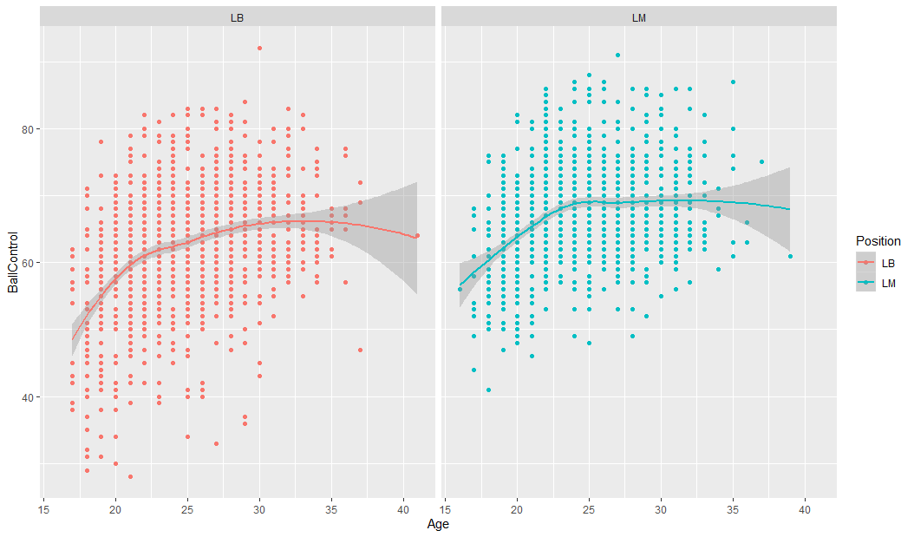
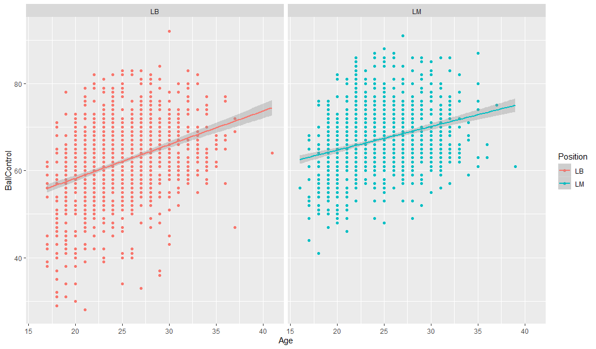
Part 2: Looking Closer at Relationship Between Ball Control and Age
4. As expected, there is some evidence of a positive correlation between Ball Control and Age although it looks like it might depend on position and that there is evidence that it is not linear.
FIFA3 %>% ggplot(aes(x = Age, y = BallControl, color = Position)) + geom_point() + geom_smooth(method = "loess") + facet_wrap(~Position)
FIFA3 %>% ggplot(aes(x = Age, y = BallControl, color = Position)) + geom_point() + geom_smooth(method = "lm") + facet_wrap(~Position)
Upon further review there is evidence of non linearity from the loess fit although there does not seem to be much visual evidence that the relationship is different between the positions.

Slide 13
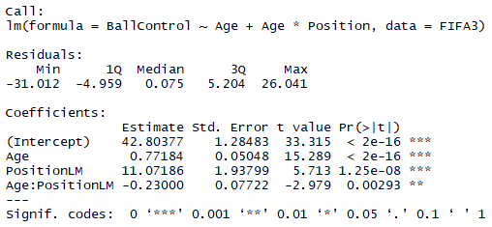
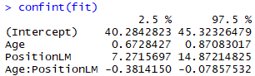
Part 2: Looking Closer at Relationship Between Ball Control and Age
4. As expected, there is some evidence of a positive correlation between Ball Control and Age although it looks like it might depend on position and that there is evidence that it is not linear.
In the linear model case, we can test the equality of the slopes as an exploratory measure. You will study this in depth in Stat 1. This is just a preview … this was more in depth than was expected at this point.
fit = lm(BallControl~Age + Age*Position, data = FIFA3)
summary(fit)
FIFA3 %>% ggplot(aes(x = Age, y = BallControl, color = Position)) + geom_point() + geom_smooth(method = "lm") + facet_wrap(~Position)
There is sufficient statistical evidence to conclude that the relationship between Ball Control and Age is different between the LM and LB positions. It is estimated that for every one year increase in age, the increase in ball control is .23 points less for LM than for LF. (pvalue = .00293). A 95% confident interval for this decrease is (.08, .38) points.

Slide 14
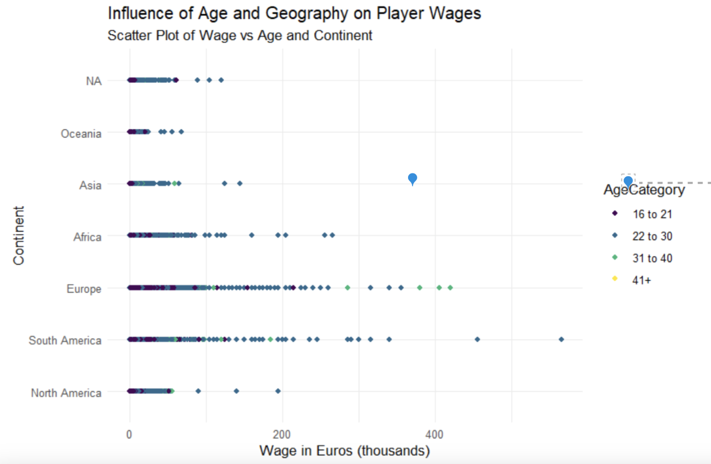

Slide 15
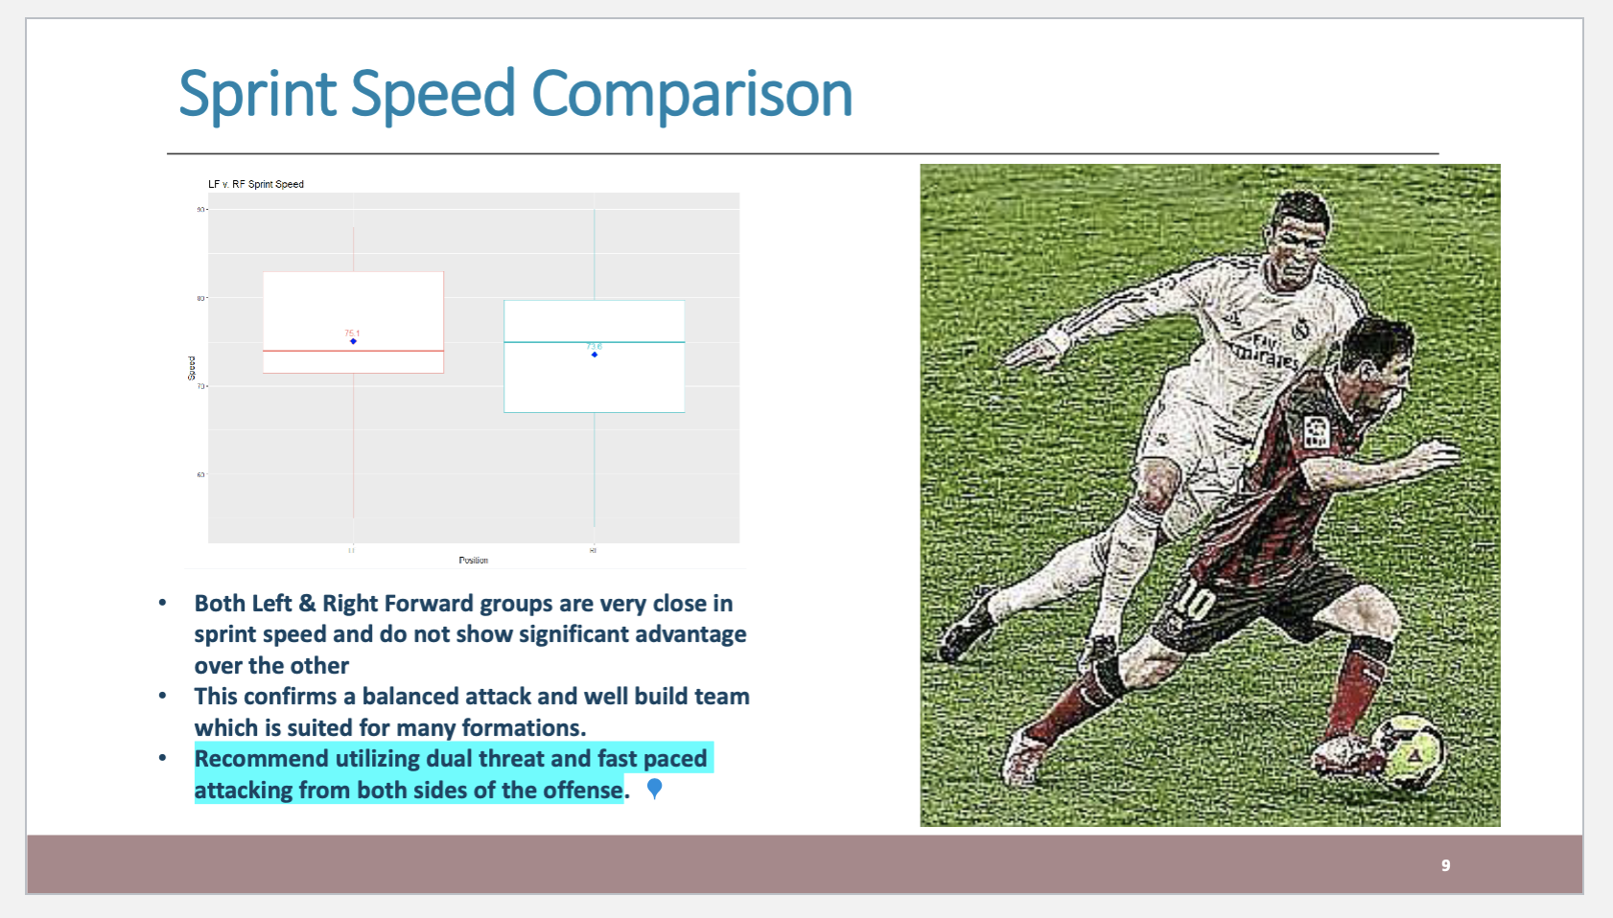
Call to Action

Slide 16
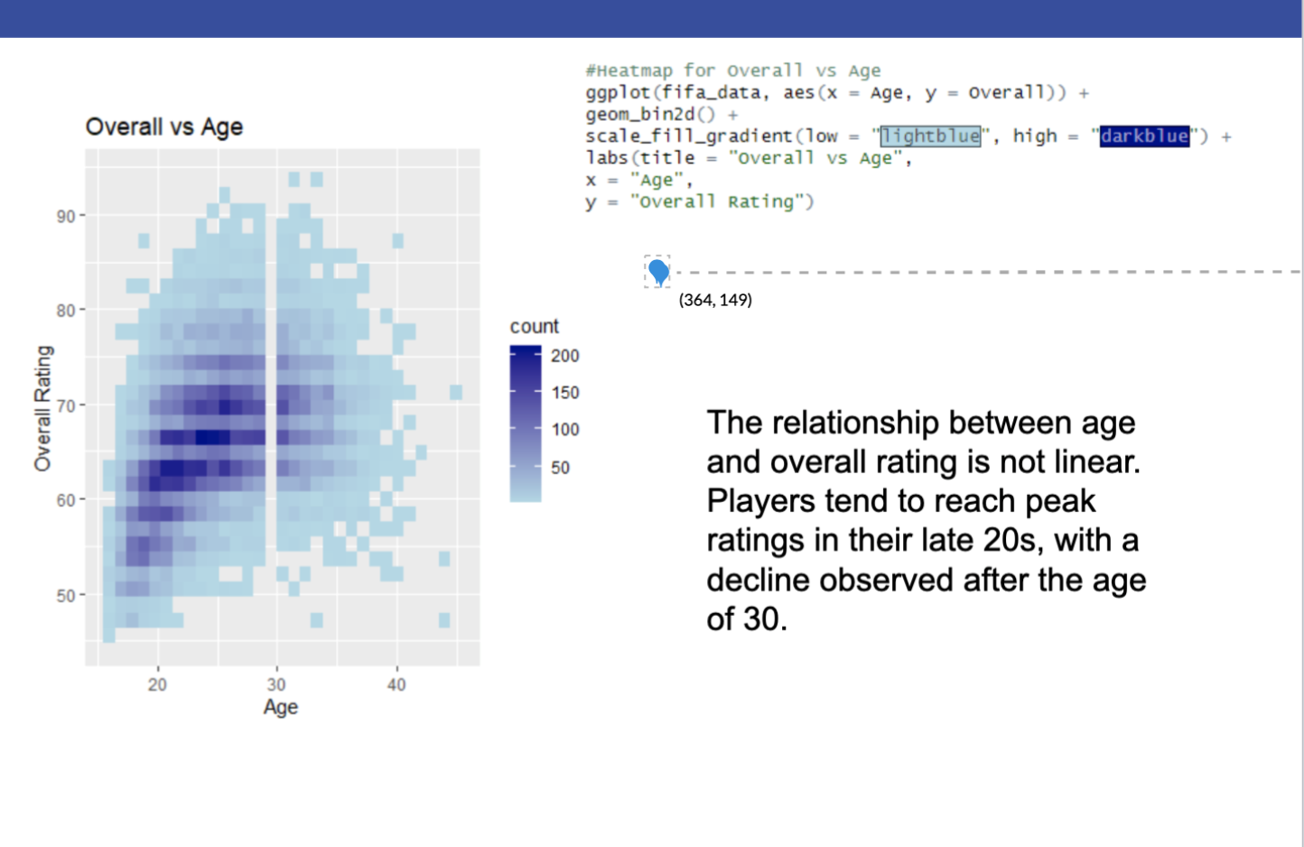
Overall vs Age

Slide 17
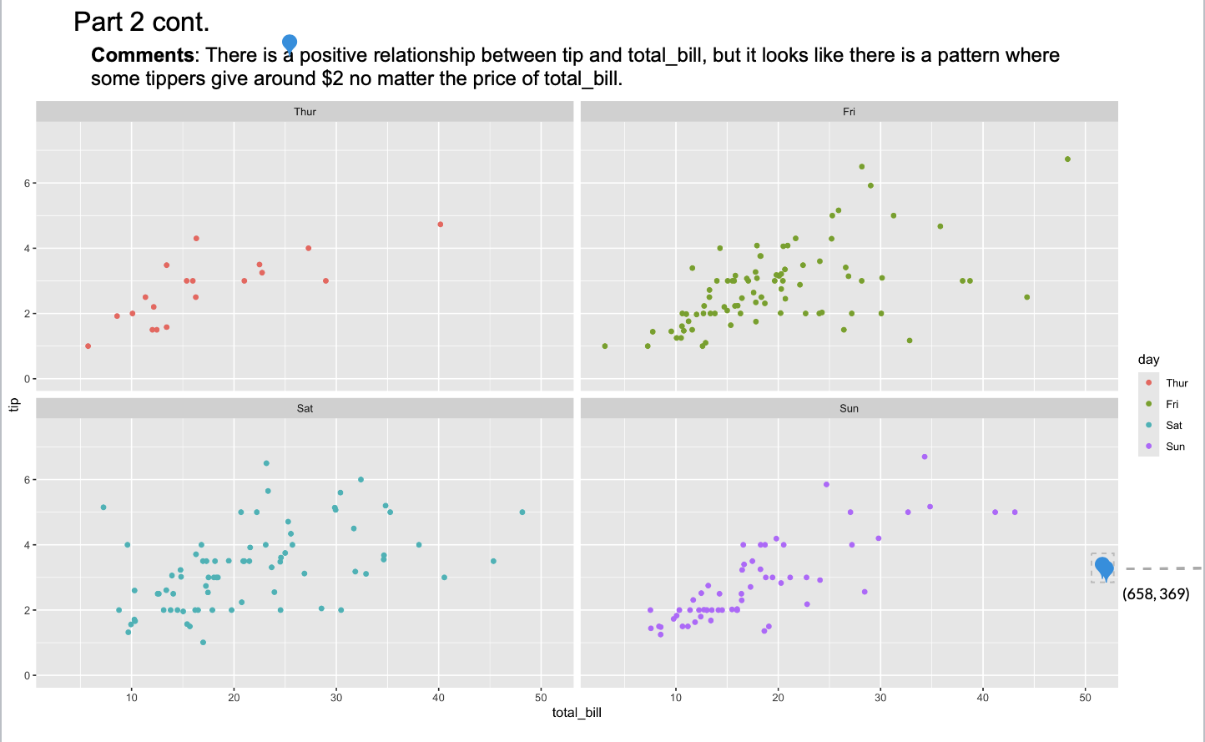
Breakout! Tips! ☺

Slide 18
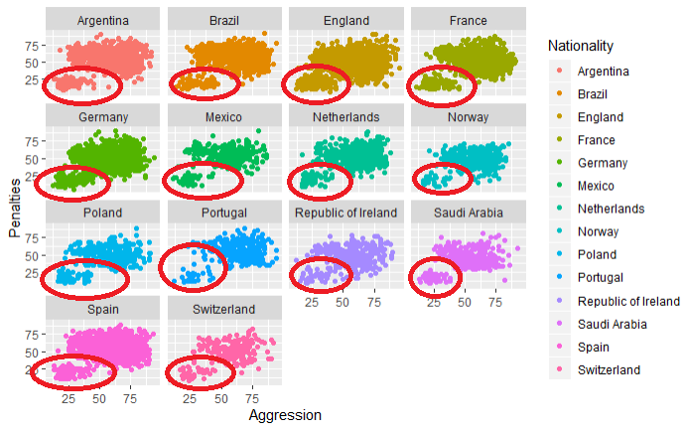
Another Look at Aggression and Penalties by Nationality
Looking at Aggression vs Penalties by Nationality, nothing stands out that well. But it’s interesting to see that all the graphs show a group of outliers with low aggression and low penalties. Could these be players in certain positions? Some other variable that distinguishes these players? Could certain nationalities have correlation with this other mystery attribute? Let’s try position first.

Slide 19
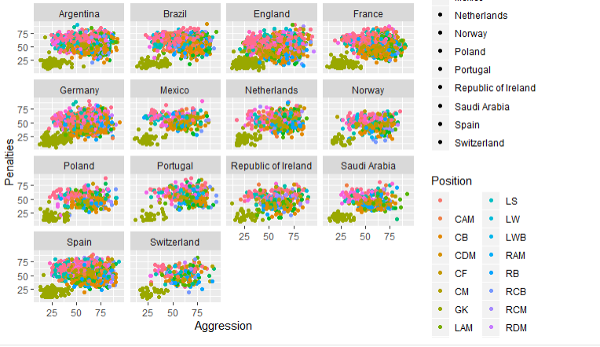
The Goalkeepers have low aggression and penalties
Goal Keeper = GK (green group in the lower left of each plot)

Slide 20
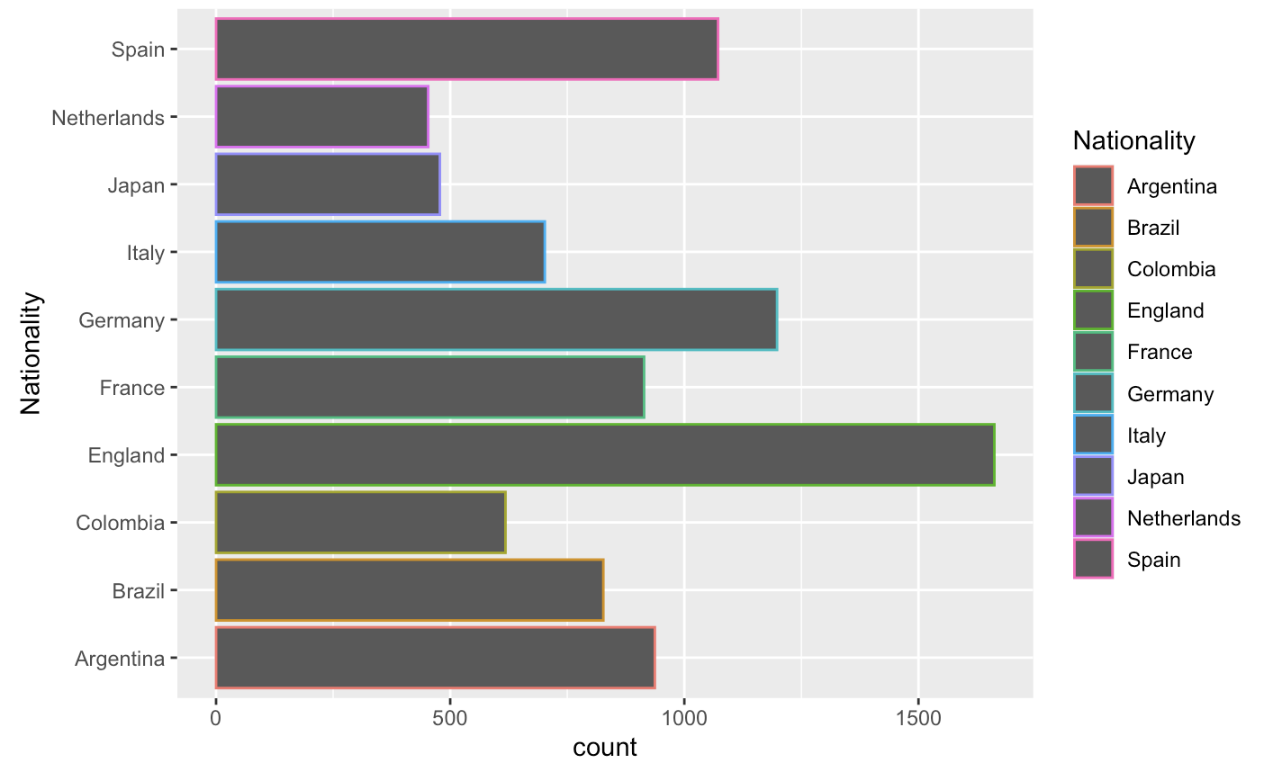
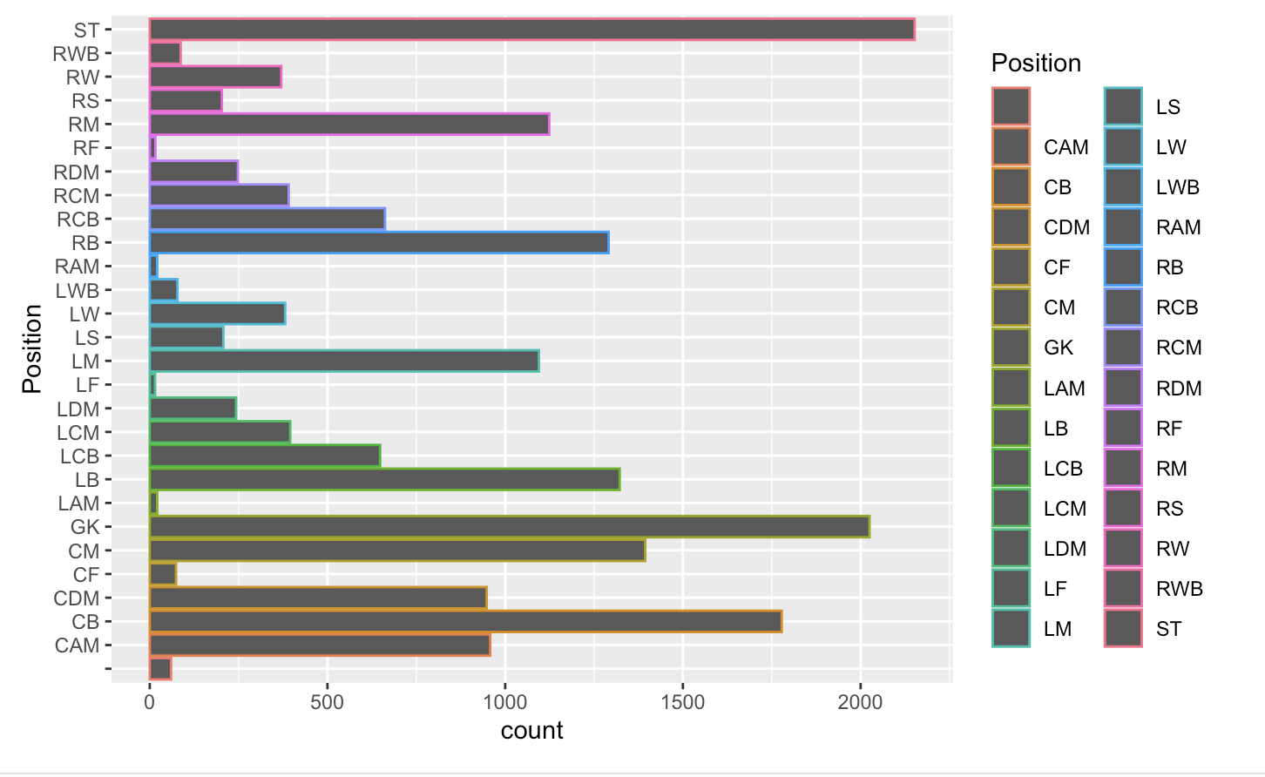
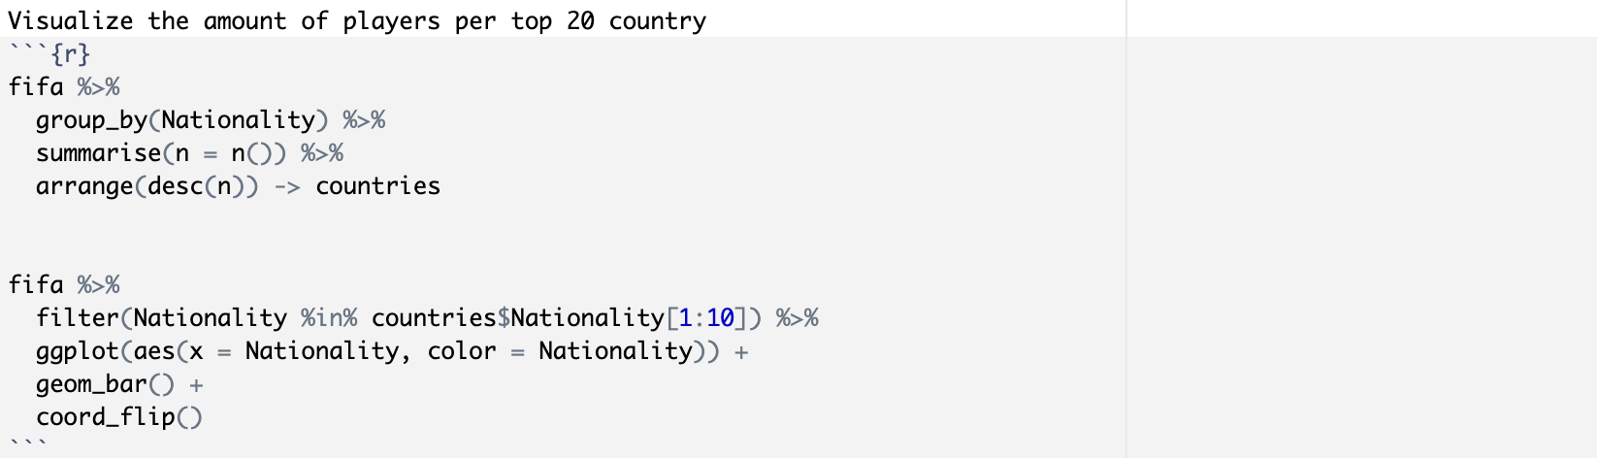
Part 2
First, I want to visualize the data. I’m curious how the positions are distributed, as well as which countries produce the most top-level football players.

Slide 21
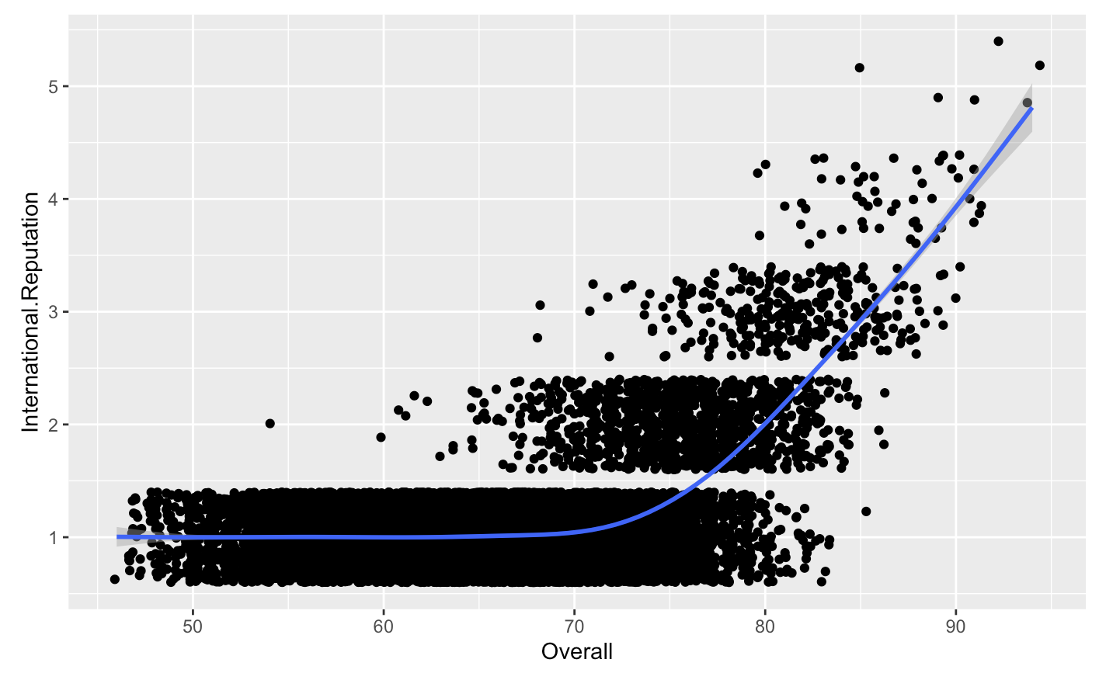
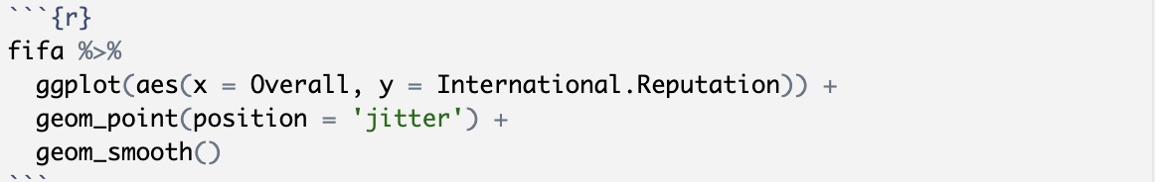
Part 2
This makes me wonder about which countries produce the most talented football players.
We will look at the columns ‘overall’ and ‘international.reputation’ as a proxy for talent.
It appears that players do not gain International Reputation unless their ‘Overall’ is greater than 60, so we will limit the search for talented players there.

Slide 22
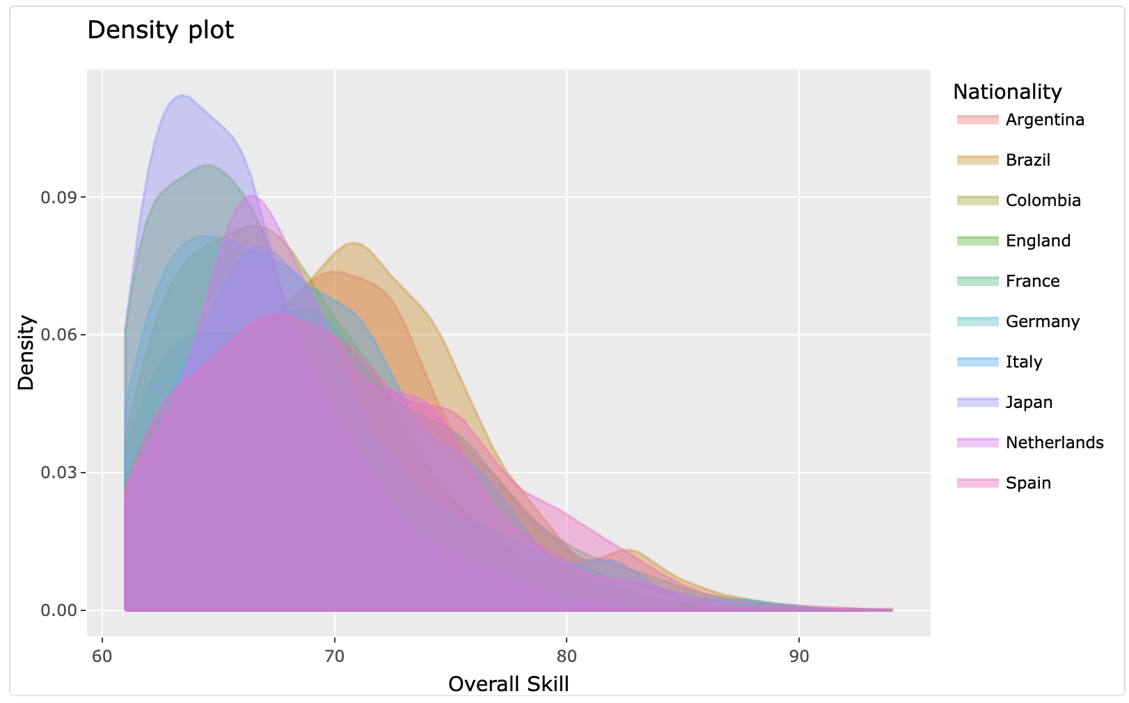
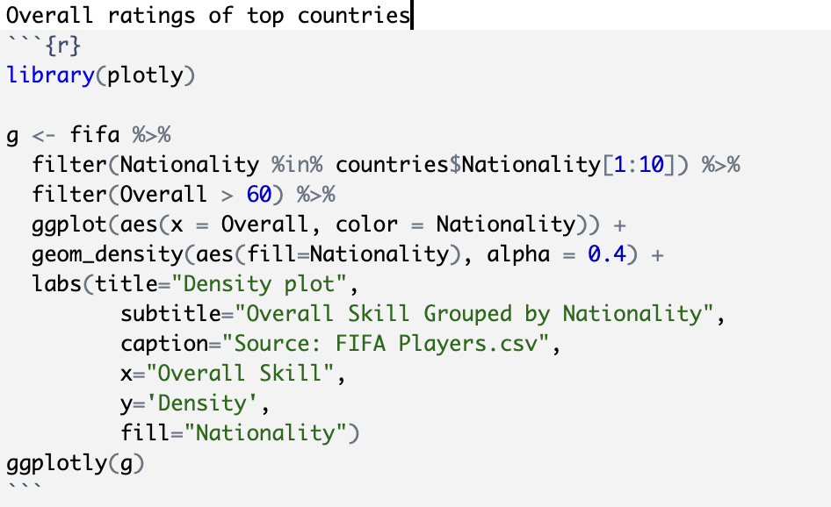
Part 2
Argentina and Brazil are clearly outliers. It would be interesting, time permitting, to check whether the mean Overall ratings of this subset are statistically different.

Slide 23
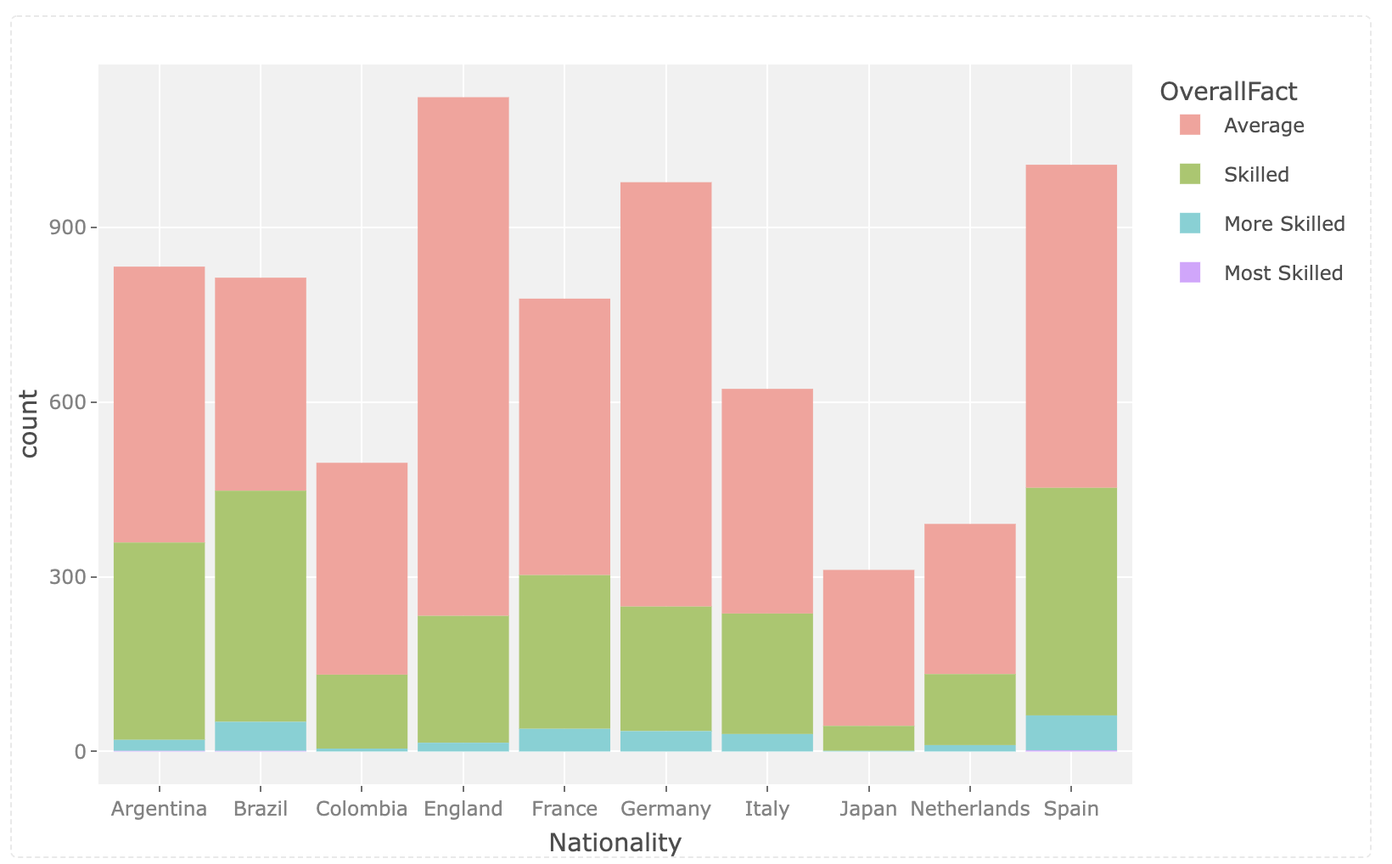
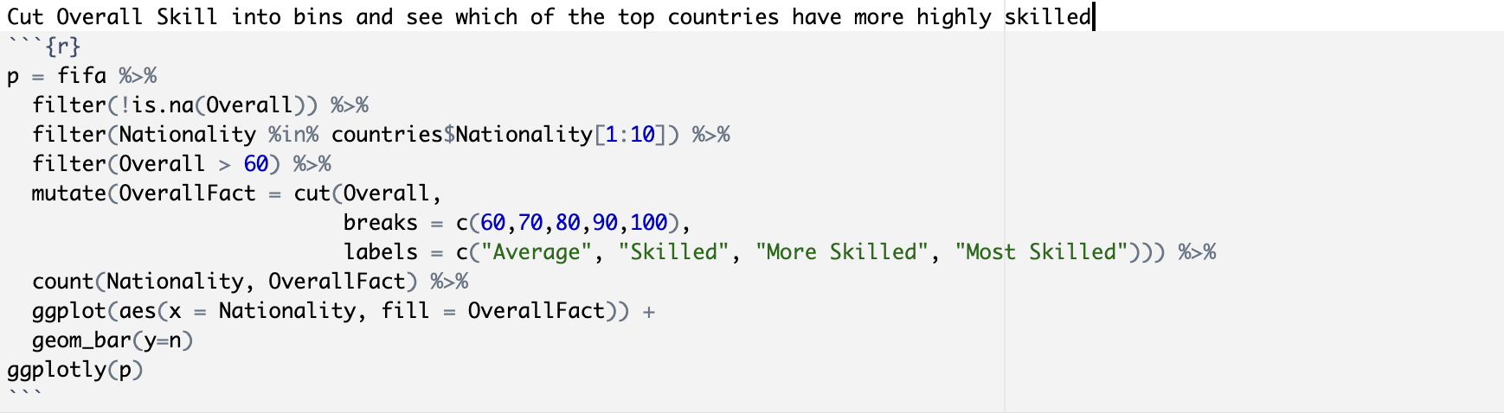
Part 2
For the top ten countries, I would like to look at the relative ratios of top players, cut into skill bins.
Some countries have a much higher proportion of highly skilled players compared to their overall contribution.
It would be interesting to explore how exactly these ratios compare.
I would also like to measure them vs. the population of the country. Integrating CIA Factbook data to compare could be a future project.

Slide 24
For Live Session: Unit 3
Part 3: Takeaways and Question for Live Session
What were your 3-5 (or more) key takeaways from this unit?
Were there any questions you had or topics that were fuzzy? (There is no minimum here. However, if you don’t have any questions, please simply state, “I didn’t have any questions, everything was pretty clear!” (or something to that effect.) ☺

